Slide 1
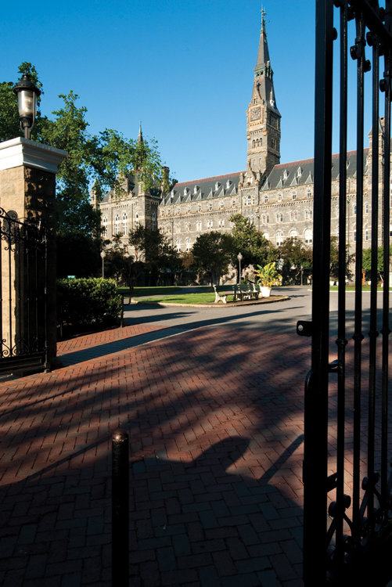
The Policy Writing Process
The Writing Center

Slide 2
Strategic Communication:
What is it?
The ability to think critically about context, purpose, genre, and audience, and to communicate strategically to address that specific situation. Strategic communication requires a set of specific and complex skills that everyone can develop and improve, and is integral to powerful, ethical, and innovative leadership.

Slide 3
Policy Writing:
What is it?
“Our purpose is to understand what our readers need to know to fulfill their mission or achieve their goals and then to provide them with interesting policy stories, based on persuasive evidence and rigorous data analysis and told with integrity to the facts” (Chrisinger 6).

Slide 4

Understanding Writing as a
(Messy) Process
“Almost all good writing begins with terrible first efforts. You need to start somewhere. Start by getting something -- anything -- down on paper. A friend of mine says that the first draft is the down draft -- you just get it down. The second draft is the up draft -- you fix it up. You try to say what you have to say more accurately. And the third draft is the dental draft, where you check every tooth, to see if it's loose or cramped or decayed, or even, God help us, healthy.” –Anne Lamott, “Shitty First Drafts”

Slide 5
The Writing Process
PHASE I: PREPARATION
Brainstorming
Freewriting
Mind mapping
Topic Identification
Research question
The stakes
Line of inquiry
Research
Finding sources
Considering multiple perspectives
Planning
Outlining
Assessing the Context
Prewriting
Considering the audience
Understanding parameters and expectations
Genre identification
Creating a bibliography

Slide 6
The Writing Process
PHASE II: COMPOSITION
Drafting
Composing the central claim
Composing the introduction, body, and conclusion
Composing the Executive Summary
Feedback
Synthesizing source material
Articulating and addressing counterarguments
Peer Review

Slide 7
The Writing Process
PHASE III: FINALIZING
Revisions
Clarifying and accepting feedback
Editing
Correcting the formatting
Proofreading
Editing for typos
Submission/Publication
Revision planning
Making substantive changes
Correcting mechanics and word choice
Editing for concision and tone

Slide 8
Finalizing
Revision | Editing | Proofreading
SUBSTANTIVE CHANGES | LOWER-ORDER CHANGES | FINAL CHECK
Answer/solution | Format | Typos
Structure | Style/Tone
Evidence | Word choice
Argumentation | Concision
 | Grammatical Conventions

Slide 9
Works Cited
LaMott, Anne. Bird by Bird. Anchor Books, 1995.

